Slide 1

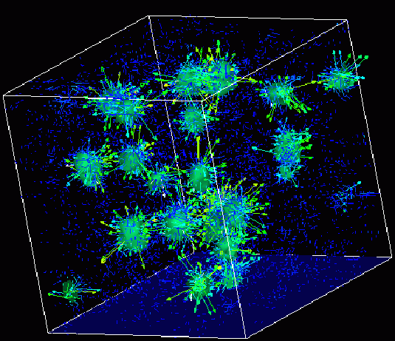
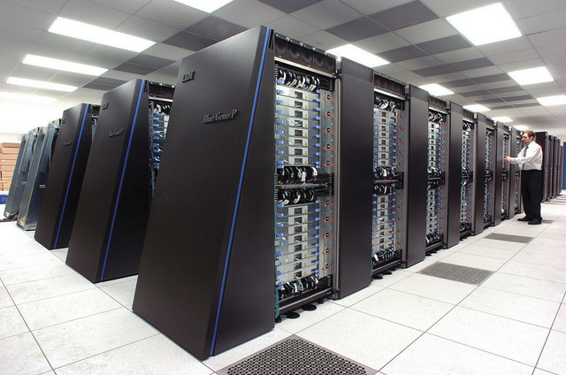
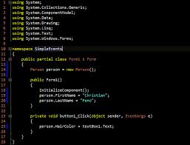
Advanced
Scientific Computing
(SciComp 201)
Session 03
Nuclear Models, Quantum Mechanics

Slide 2
Session Goals
Set width and precision of numeric output in C++
Understand how double-slit diffraction enables measurement of wavelengths
Predict spectral emission lines from Hydrogen using the Rydberg Formula
Discuss evolution of early atomic models
Develop the Bohr Atomic Model for Hydrogen
Calculate spectral lines using the Bohr Atomic Model
Compare Rydberg Formula to Bohr Model

Slide 3

Numeric Formatting in C++
Total field width
Digits to display
Uses current precision to set number of digits to right of decimal. Does not use exponents & applies rounding if necessary

Slide 4
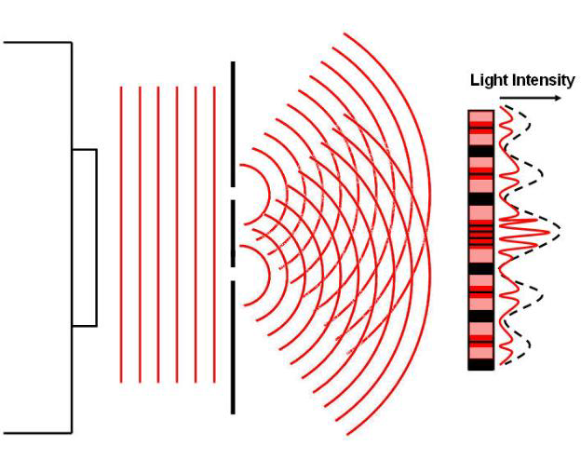
Double Slit Diffraction

Slide 5
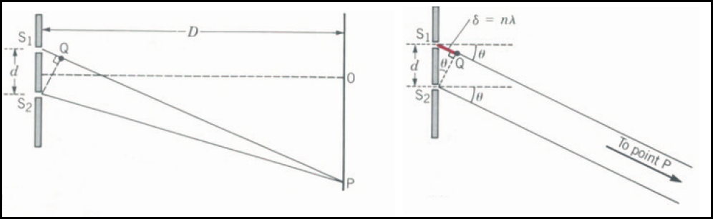



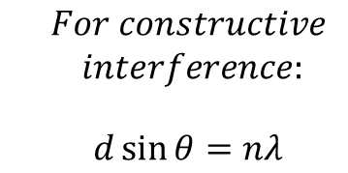
Double Slit Diffraction
$D⋙d$ $⟹$ $\overline{S_{1}P}∥\overline{S_{2}P}∴δ=d\sin{θ}$
$$For constructive \\ interference:$$
$$d\sin{θ}=nλ$$
Wavelengths of (4) Visible Emission Lines after heating pure Hydrogen
$$λ=\frac{d\sin{θ}}{n}$$

Slide 6
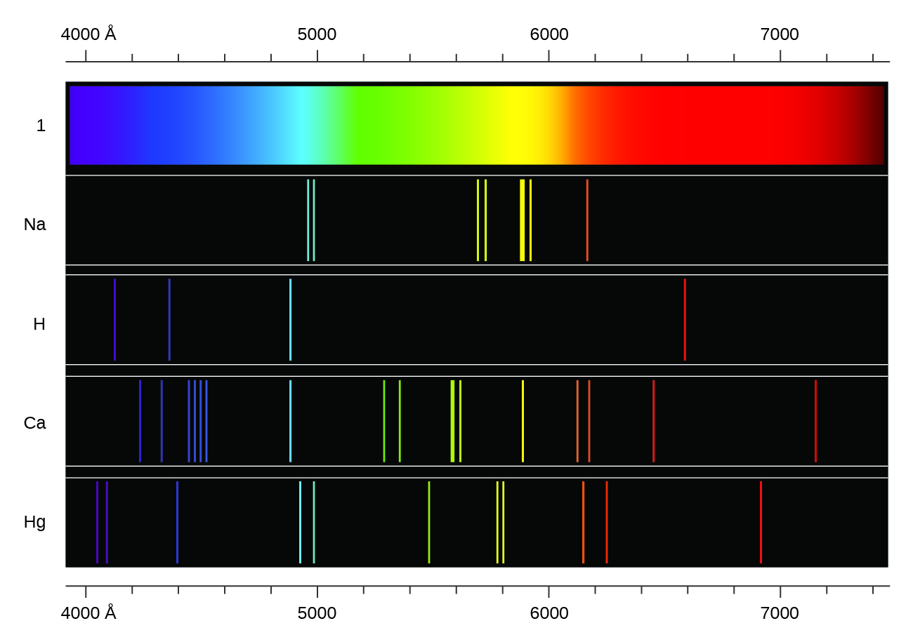
Spectral Emission Lines

Slide 7
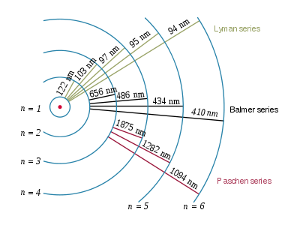
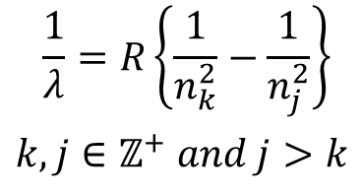


Spectral Emission Lines
Hydrogen Emission Lines
Rydberg Formula
$$\frac{1}{λ}=R\left\{\frac{1}{n_{k}^{2}}−\frac{1}{n_{j}^{2}}\right\}$$ $k,j∈ℤ^{+} and j>k$
$$Rydberg Constant \\ R=1.0967757×{10}^{7}m^{−1}$$
$$nm=1×{10}^{−9}m$$

Slide 8
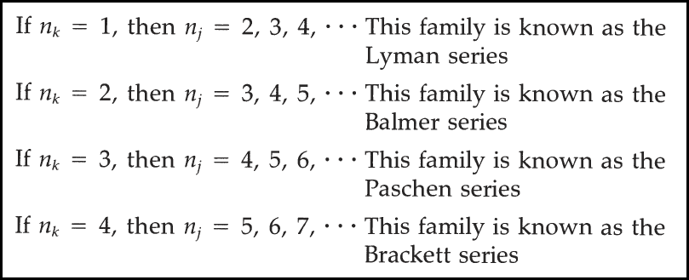
Lab 1 – Spectrum of Hydrogen
https://en.wikipedia.org/wiki/Hydrogen_spectral_series
Write a C++ console application to generate the anticipated wavelengths of the spectral emission of Hydrogen using the Rydberg formula
For each family from the Lyman to the Brackett series, display the first five (5) wavelengths in each series

Slide 9
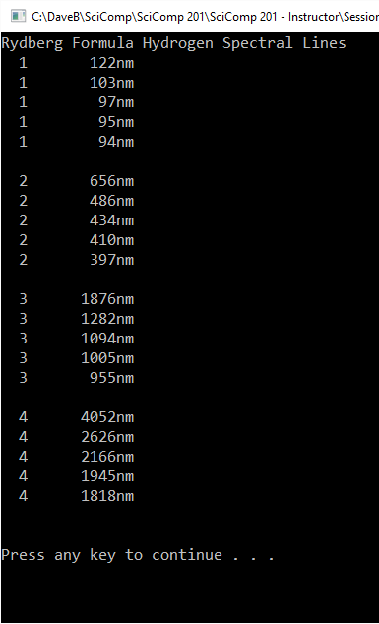
Lab 1 – Spectrum of Hydrogen

Slide 10

Formulas $≠$ Physics
Rydberg developed his formula in 1888 and it was later extended by Ritz to account for all known atoms
But it will still only an empirical formula – there was no explanation given as to why the formula worked
Fitting a curve and then making accurate predictions is still not physics if you don’t understand the laws that can derive the equation
It took the next 50 years for science to understand the true nature of the formula and to realize the source of Rydberg’s constant

Slide 11
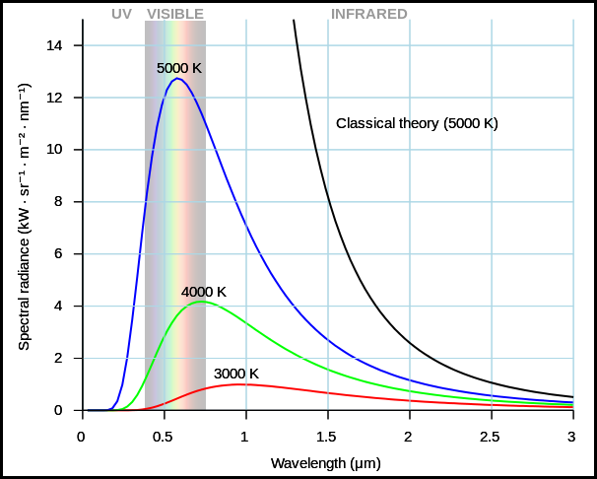
The Ultraviolet Catastrophe

Slide 12
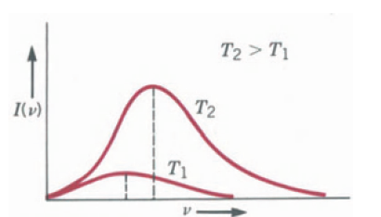
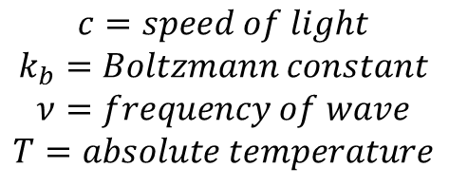

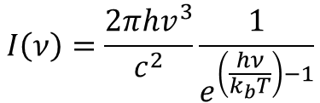

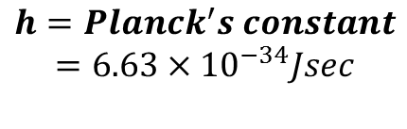

Max Planck’s Quantum - 1900
$$I\left(ν\right)=\frac{2πhv^{3}}{c^{2}}\frac{1}{e^{\left(\frac{hν}{k_{b}T}\right)−1}}$$
$$c=speed of light \\ k_{b}=Boltzmann constant \\ ν=frequency of wave \\ T=absolute temperature$$
$$I_{T}=\int_{0}^{∞}{I\left(ν\right)dν=σT^{4}}$$
$$h=Planck^{′}s constant \\ =6.63×{10}^{−34}Jsec$$
$$σ=5.67×{10}^{−8}\frac{W}{m^{2}K^{4}}$$
$$Δ_{Energy}=hν$$

Slide 13
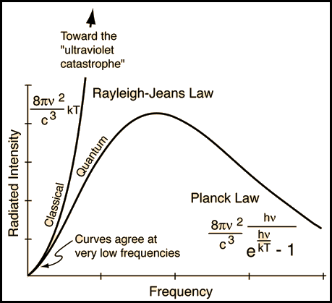
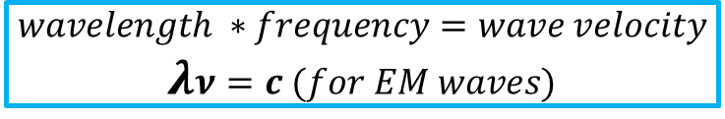
The Ultraviolet Catastrophe
$$wavelength ∗frequency=wave velocity \\ λν=c (for EM waves)$$

Slide 14
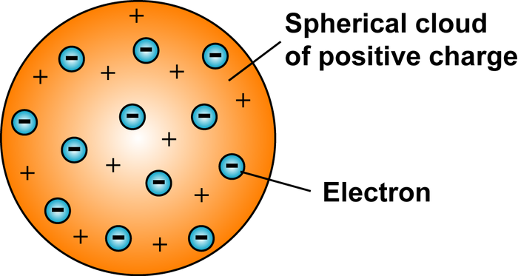
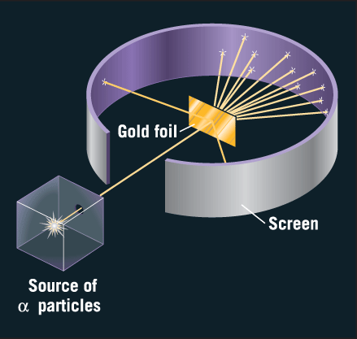
Atomic Model – J.J. Thomson - 1904
E. Rutherford Experiment
Rutherford scattering indicated atoms have a heavy & compact nucleus

Slide 15
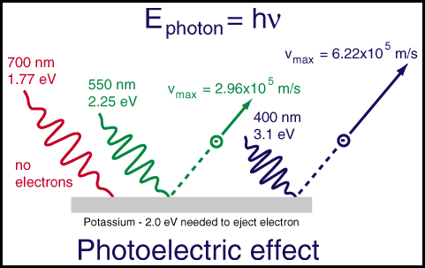
Einstein’s Quantum - 1905

Slide 16
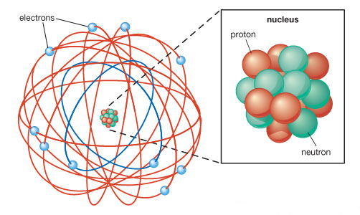
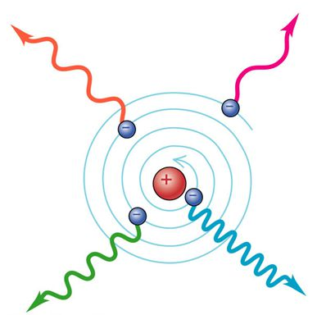
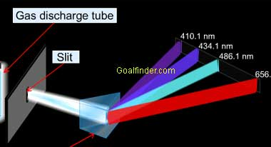
Atomic Model – E. Rutherford - 1911
The Rutherford model indicated stable atoms should emit radiation (but they don’t), and it could not explain discrete spectral emission lines

Slide 17
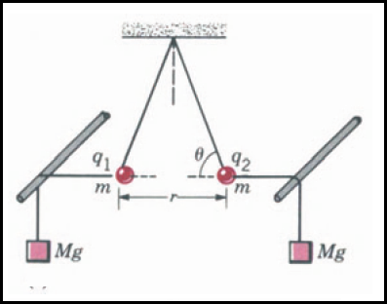
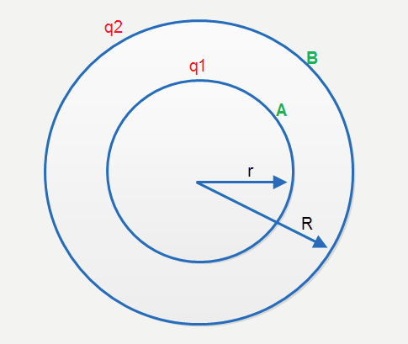
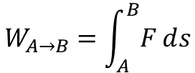


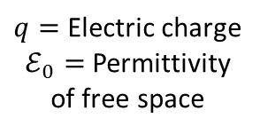


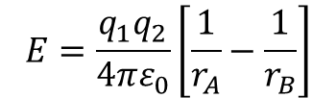


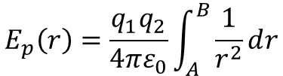
Electric Field Potential
$$Coulomb^{′}s Law$$
$$F∝\frac{q_{1}q_{2}}{r^{2}}⟹F=k\frac{q_{1}q_{2}}{r^{2}}$$
$$k=\frac{1}{4πε_{0}}$$
Eq 1
$$F=\frac{q_{1}q_{2}}{4πε_{0}r^{2}}$$
$q=$ Electric charge
$ℰ_{0}=$Permittivity of free space
Electric Field Potential
$$E=\frac{q_{1}q_{2}}{4πε_{0}}\left[\frac{1}{r_{A}}−\frac{1}{r_{B}}\right]$$
$$W_{A→B}=\int_{A}^{B}{Fⅆs}$$
A as reference point $∴$ $r_{B}=∞$
$$E_{p}\left(r\right)=\frac{q_{1}q_{2}}{4πε_{0}}\int_{A}^{B}{\frac{1}{r^{2}}ⅆr}$$
Eq 2
$$E=\frac{q_{1}q_{2}}{4πε_{0}r}$$

Slide 18
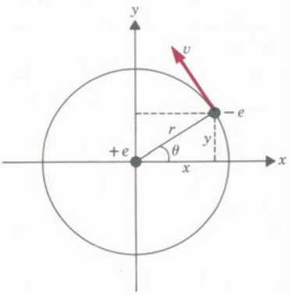
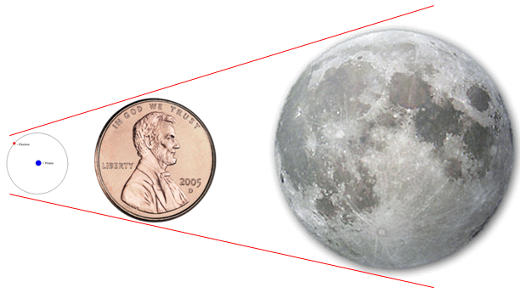
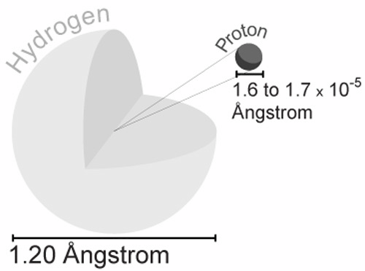


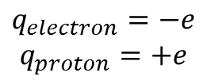





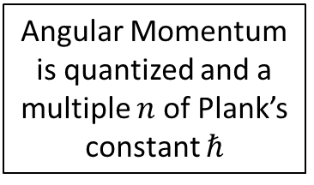
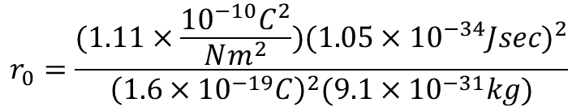
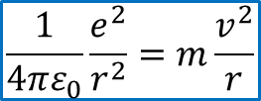

Atomic Model – N. Bohr - 1913
$$v=n\frac{ℏ}{mr}$$
Angular Momentum is quantized and a multiple $n$of Plank’s constant $ℏ$
$$L=mvr=nℏ$$
$$\frac{1}{4πε_{0}}\frac{e^{2}}{r^{2}}=\frac{m}{r}n^{2}\frac{ℏ^{2}}{m^{2}r^{2}}$$
$$h=2πℏ$$
$$r=n^{2}\frac{4πε_{0}ℏ^{2}}{e^{2}m}$$
Eq 4
$$F=\frac{q_{1}q_{2}}{4πε_{0}r^{2}}$$
Eq 1
$$r_{0}=\frac{(1.11×\frac{{10}^{−10}C^{2}}{Nm^{2}}){(1.05×{10}^{−34}Jsec)}^{2}}{{\left(1.6×{10}^{−19}C\right)}^{2}(9.1×{10}^{−31}kg)}$$
$$q_{electron}=−e \\ q_{proton}=+e$$
$$r_{0}=0.53×{10}^{−10}=0.53 Å$$
$$F_{radial}=m{∗a}_{radial}$$
$$\frac{1}{4πε_{0}}\frac{e^{2}}{r^{2}}=m\frac{v^{2}}{r}$$
Eq 3

Slide 19

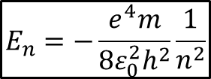
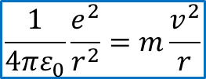
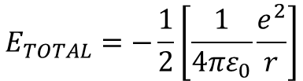

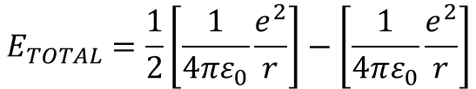

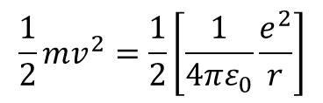

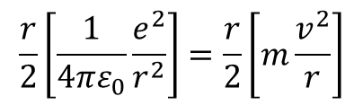

Atomic Model – N. Bohr - 1913
Eq 2
$$E=\frac{q_{1}q_{2}}{4πε_{0}r}$$
$$E_{TOTAL}=kinetic +potential$$
$$E_{TOTAL}=\frac{1}{2}mv^{2}−\frac{1}{4πε_{0}}\frac{e^{2}}{r}$$
$$E_{TOTAL}=\frac{1}{2}\left[\frac{1}{4πε_{0}}\frac{e^{2}}{r}\right]−\left[\frac{1}{4πε_{0}}\frac{e^{2}}{r}\right]$$
Eq 3
$$\frac{1}{4πε_{0}}\frac{e^{2}}{r^{2}}=m\frac{v^{2}}{r}$$
$$E_{TOTAL}=−\frac{1}{2}\left[\frac{1}{4πε_{0}}\frac{e^{2}}{r}\right]$$
$$\frac{r}{2}\left[\frac{1}{4πε_{0}}\frac{e^{2}}{r^{2}}\right]=\frac{r}{2}\left[m\frac{v^{2}}{r}\right]$$
$$r=n^{2}\frac{4πε_{0}ℏ^{2}}{e^{2}m}$$
Eq 4
$$h=2πℏ$$
$$\frac{1}{2}mv^{2}=\frac{1}{2}\left[\frac{1}{4πε_{0}}\frac{e^{2}}{r}\right]$$
$$E_{n}=−\frac{e^{4}m}{8ε_{0}^{2}h^{2}}\frac{1}{n^{2}}$$
Eq 5

Slide 20
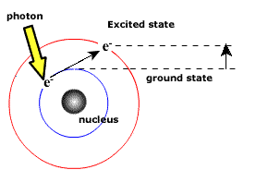


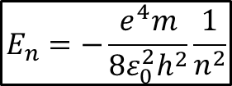
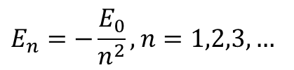
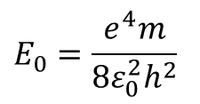

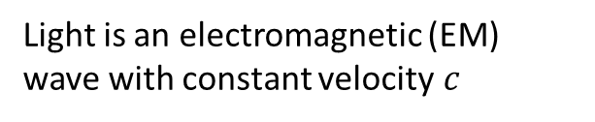
Atomic Model – N. Bohr - 1913
$$E_{n}=−\frac{e^{4}m}{8ε_{0}^{2}h^{2}}\frac{1}{n^{2}}$$
Eq 5
$$E_{0}=\frac{e^{4}m}{8ε_{0}^{2}h^{2}}$$
$$E_{n}=−\frac{E_{0}}{n^{2}},n=1,2,3,…$$
$$E_{final}−E_{initial}=hν$$
Einstein’s Photon Quantum
$$ν=\frac{E_{f}−E_{i}}{h}$$
Exciting a photon from a lower initial state to a higher final state requires Energy
$$ν=\frac{c}{λ}$$
Light is an electromagnetic (EM) wave with constant velocity$c$

Slide 21

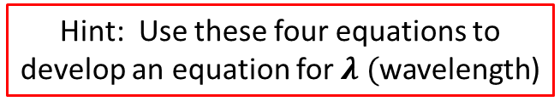

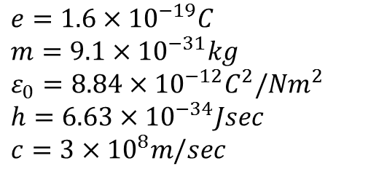


Lab 2 – Bohr Model Spectral Lines
Write a C++ console application to generate the anticipated wavelengths of the spectral emission of Hydrogen (for the same series as Lab 1) using Bohr’s Atomic model
$$E_{0}=\frac{e^{4}m}{8ε_{0}^{2}h^{2}}$$
$$e=1.6×{10}^{−19}C \\ m=9.1×{10}^{−31}kg \\ ε_{0}=8.84×{10}^{−12}C^{2}/Nm^{2} \\ h=6.63×{10}^{−34}Jsec \\ c=3×{10}^{8}m/sec$$
$$E_{n}=−\frac{E_{0}}{n^{2}}, n=1,2,3,…$$
$$ν=\frac{E_{f}−E_{i}}{h},\left(i,f∈ℤ^{+}\right), f>i$$
Hint: Use these four equations to develop an equation for $λ ($wavelength)
$$c=νλ$$

Slide 22

Lab 2 – Bohr Model Spectral Lines

Slide 23










Atomic Model – N. Bohr - 1913
$$E_{n}=−\frac{e^{4}m}{8ε_{0}^{2}h^{2}}\frac{1}{n^{2}}$$
$$E_{0}=\frac{e^{4}m}{8ε_{0}^{2}h^{2}}$$
$$E_{n}=−\frac{E_{0}}{n^{2}},n=1,2,3,…$$
$$E_{initial}−E_{final}=hν$$
$$\frac{1}{λ}=\frac{E_{0}}{hc}\left(\frac{1}{n_{f}^{2}}−\frac{1}{n_{i}^{2}}\right)$$
$$ν=\frac{E_{i}−E_{f}}{h}$$
$$R_{Bohr}=\frac{E_{0}}{hc}=\frac{e^{4}m}{8ε_{0}^{2}h^{3}c}$$
$$ν=\frac{\left\{−\frac{E_{0}}{n_{i}^{2}}\right\}−\left\{−\frac{E_{0}}{n_{f}^{2}}\right\}}{h}$$
$$R_{Bohr}=1.09740×{10}^{7}m^{−1}$$
$$ν=\frac{c}{λ}$$

Slide 24




Atomic Model – N. Bohr - 1913
Rydberg Formula
Bohr Formula
$$\frac{1}{λ}=R\left\{\frac{1}{n_{k}^{2}}−\frac{1}{n_{j}^{2}}\right\}$$ $where k,j∈ℤ^{+} and j>k$
$$\frac{1}{λ}=R_{Bohr}\left(\frac{1}{n_{f}^{2}}−\frac{1}{n_{i}^{2}}\right)$$ $where f,i∈ℤ^{+} and f>i$
$$Rydberg Constant \\ R=1.0967757×{10}^{7}m^{−1}$$
$$Bohr Constant \\ R_{Bohr}=1.09740×{10}^{7}m^{−1}$$
Now we are doing physics!
There is now a logical assemblage of physical and mathematical laws to derive an empirical rule!

Slide 25


Atomic Model – N. Bohr - 1913

Slide 26
Atomic Model – N. Bohr - 1913
The Bohr Model still had problems!

Slide 27

Bohr Model Ignores Electron “Spin”

Slide 28
Now you know…
How to set the width and precision of numeric output
Double-slit diffraction enables measurement of wavelengths
The Rydberg Formula indicated an underlying model existed, but an equation without an explanation is just a nifty observation
Consider the plight of early atomic models – how do you measure something you cannot possibly see?
At the atomic level, Mother Nature is quantum – this violates common experience with its continuous spectrum
Don’t be scared off by a soup of complex looking symbols – learn to glide with them!

